Slide 1
Stroke Predictions
Ankit Dey

Slide 2
Problem Statement
Predict if someone is at risk for stroke based on clinical information
Useful for:
Hospitals
Can apply a general version of this model to quickly scan all patients for stroke risk
Doctors
Can apply a tuned version of this model to identify if a patient within a particular demographic is at risk for stroke

Slide 3
Dataset
From Kaggle
10 attributes containing clinical patient information
Gender, Age, Hypertension, Heart Disease, Marriage Status, Work Type, Residence Type, Average Glucose Level, BMI, Smoking Status
1 target variable identifying if a patient has had a stroke or not
Binary: 0 = No, 1 = Yes
5110 samples

Slide 4
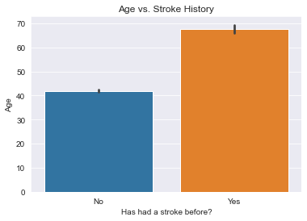

Key Finding #1
Those who have had a stroke are ~26 years older than those who have not, on average
Experimental Question: Does getting older cause biological changes that increase your risk for stroke?

Slide 5
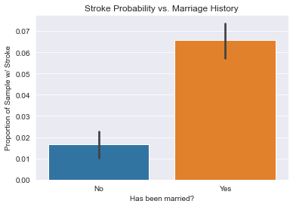
Key Finding #2
Those who have been married before are ~4x more likely to have had a stroke, on average
Experimental Question: Does getting married cause behavioral changes that increase your risk for stroke?

Slide 6
Model Evaluation - Background
Class Imbalance:
93% of samples have not had a stroke
Only 7% have had a stroke
Error Types:
False negatives – patient is predicted not to be at risk for stroke, but they actually are
May lead to lack of treatment
False positives – patient is predicted to be at risk, but they actually are not
Only leads to an unnecessary checkup
False negatives are the most important error to minimize

Slide 7
Model Evaluation - Metrics
Accuracy = 0.94
Accuracy = Correct Predictions / All Predictions
Not much higher than class imbalance of 0.93
Recall = 0.07
Recall = True Positives / (True Positives + False Negatives)
High False Negative Rate – 93% of positive samples were falsely predicted to be negative

Slide 8
Recommendations
Further research & development is required
False Negative Rate needs to be decreased to create a safe model:
Class Imbalance makes it hard to correctly identify positive samples
Only 7% of samples are positive
Resampling will improve class balance and may help decrease the False Negative Rate
E.g. Oversampling w/ SMOTE
Works by creating synthetic positive samples that have attributes close to the real positive samples
Contact: ankitkdey@gmail.com

